Slide 1

Sales Performance Analysis — AdventureWorks2019
This project delivers an interactive single-page Power BI dashboard built on the AdventureWorks2019 database. It transforms raw sales data into actionable insights using SQL, Power Query, DAX, and bookmark navigation to explore Sales, Quantity, and Profit views seamlessly.

Slide 2
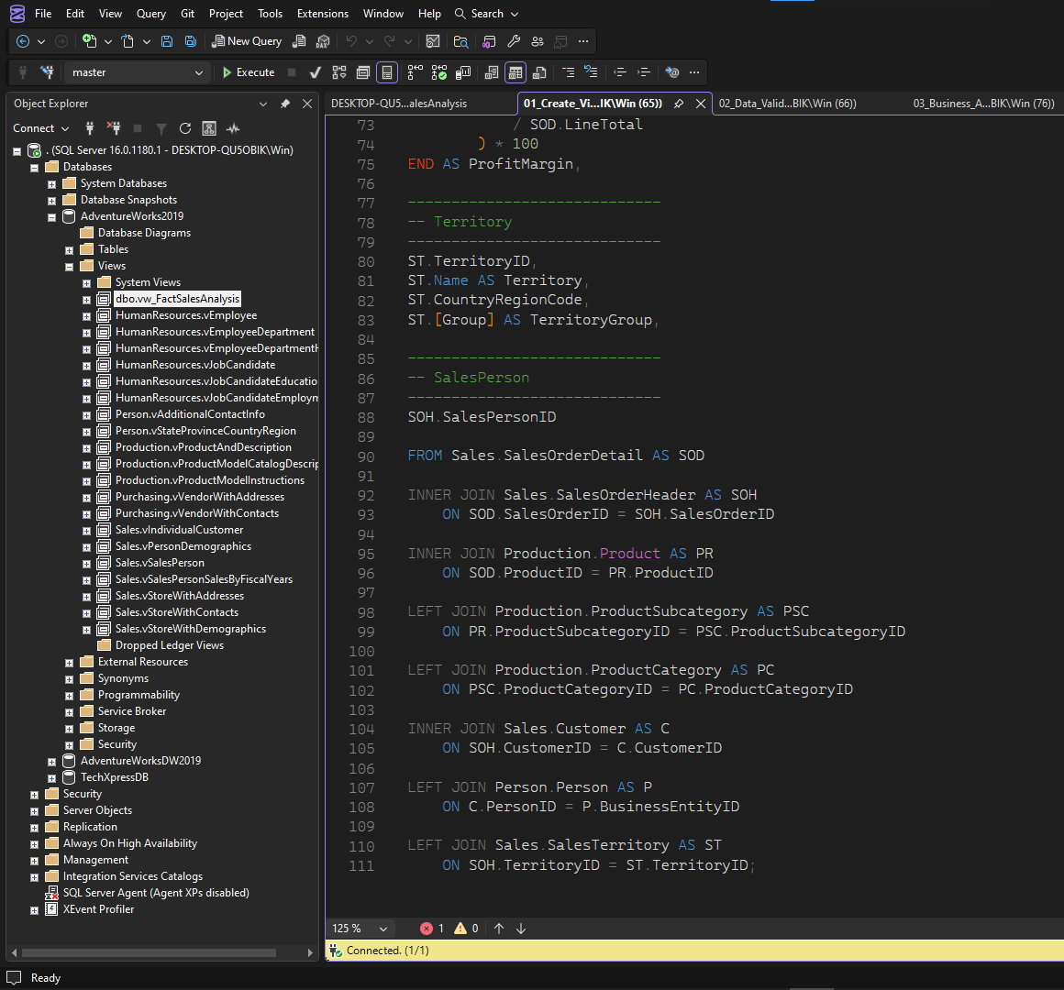
Overview
This analysis uses AdventureWorks2019 to help stakeholders monitor business performance, identify trends, evaluate profitability, and make data-driven decisions. Data was extracted with SQL Server, transformed with Power Query, modeled in Power BI, and enhanced with DAX measures for interactive reporting.

Slide 3


Business Problem
Stakeholders lacked a centralized view of sales performance across multiple perspectives, requiring navigation across many reports. The goal: provide a single, interactive dashboard that clearly surfaces overall sales performance, profitability, quantity, product and regional performance, customer metrics, and monthly trends—so decisions can be made faster.

Slide 4
Project Objectives
Analyze Sales
Monitor Profit
Track Products & Quantity
Territory Comparison
Measure total sales and trends to evaluate performance.
Track profit and profit margin with focused KPIs.
Compare performance across sales territories and regions.
Identify top products, compare categories, and track quantities sold.
Interactive UX
Single-page dashboard with bookmark navigation for Sales, Quantity, and Profit.

Slide 5
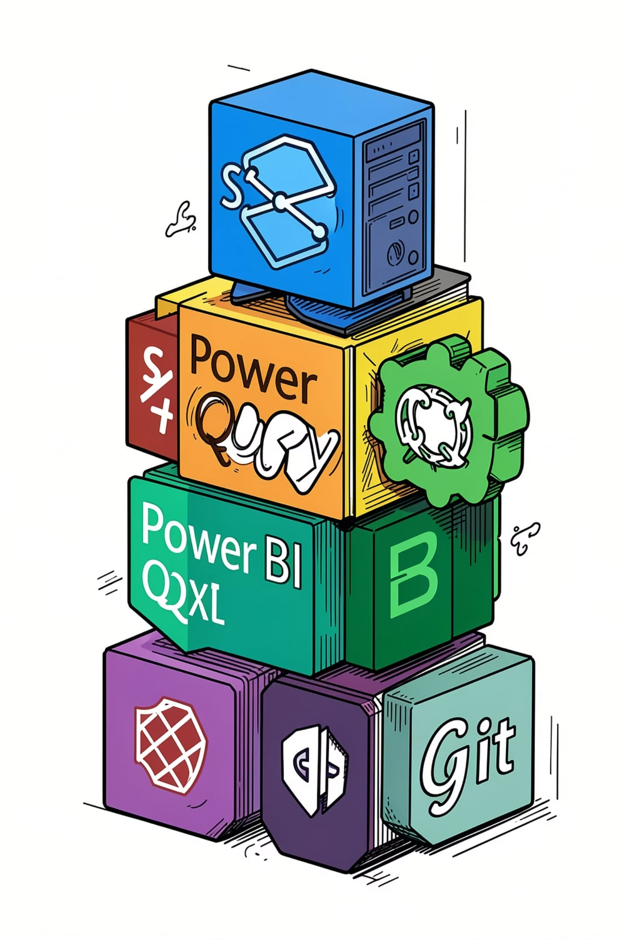
Tech Stack
SQL Server
Data extraction, cleaning, and creation of vw_FactSalesAnalysis view in SSMS.
Power Query
Transformations and Calendar table for time-based analysis.
Power BI
Single-page interactive dashboard with bookmarks and dynamic title.
DAX & Git
DAX measures for KPIs; Git/GitHub used for version control.

Slide 6

Project Workflow
Database Exploration
SQL Preparation
Import to Power BI
Power Query
Data Modeling
Create unified views for import
Transform data and add Calendar
Define relationships and keys
Inspect AdventureWorks2019 tables
Load views into the report file
This workflow traces the end-to-end process: explore AdventureWorks2019 tables, prepare a unified SQL view, import to Power BI, refine with Power Query, build relationships and model, create DAX KPIs, and assemble the single-page dashboard with bookmarks.

Slide 7
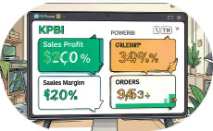
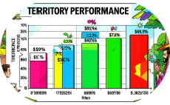
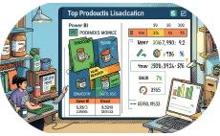
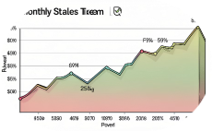
Dashboard Features
KPI Cards
Territory Analysis
Top 10 Products
Monthly Trends
Total Sales, Total Profit, Average Order Value, Profit Margin, Total Orders, Total Customers—dynamic and prominent.
Top product ranking visual to identify best-selling and highest-profit items.
Area charts for month-over-month analysis with Year and Color slicers for filtering.
Interactive bar charts to compare sales and profit by territory with cross-filtering.
Additional features: dynamic dashboard title, clear-filters button, bookmarks for Sales/Quantity/Profit, and cross-filtering between visuals for interactive exploration.

Slide 8
Key Insights
$109.8M Total Sales
$9.4M Total Profit
31.5K Orders • 19.1K Customers
Bikes Are Top Profit
Comprehensive top-line sales generated across the dataset.
Overall profit with an 8.5% profit margin—key for margin-focused decisions.
Product category analysis shows Bikes generated the highest profit.
High transaction volume and substantial customer base underpin sales figures.
Australia: Highest Profit Territory
Regional analysis reveals Australia as the most profitable territory.

Slide 9
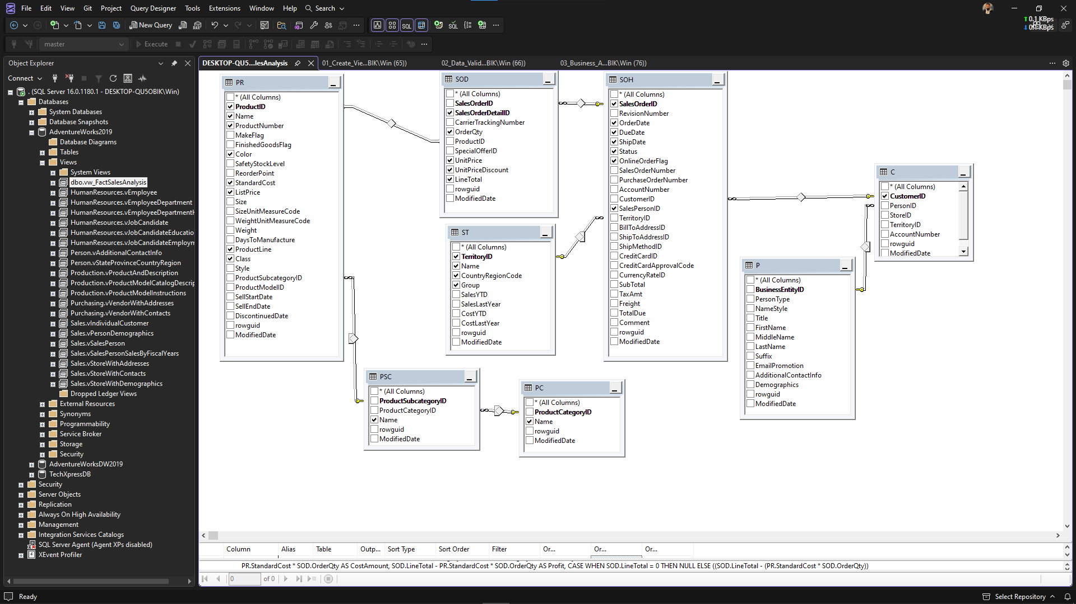
Project Structure & How to Run
Repository
Sales Performance Analysis/ with folders: 0_Data Source, 1_SQL, 2_Python, 3_Power BI, 4_Presentation, 5_Images. Key files include 01_Create_View.sql and Dashboard.pbix.
Run Steps
Restore AdventureWorks2019 in SQL Server.
Execute SQL scripts to create vw_FactSalesAnalysis.
Open the Power BI .pbix file and update connection if needed.
Refresh data and explore bookmarks and slicers.

Slide 10
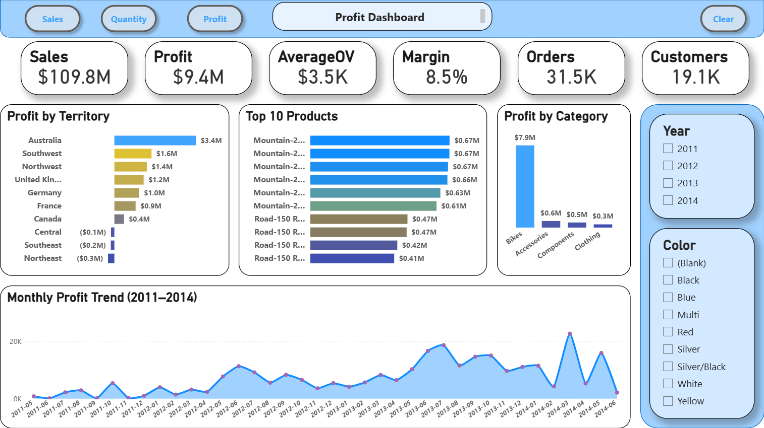
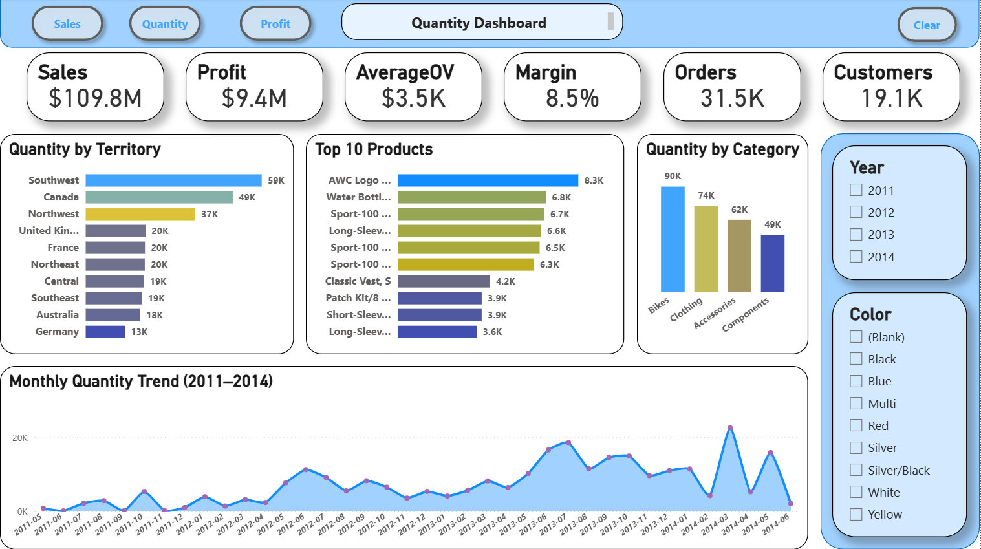
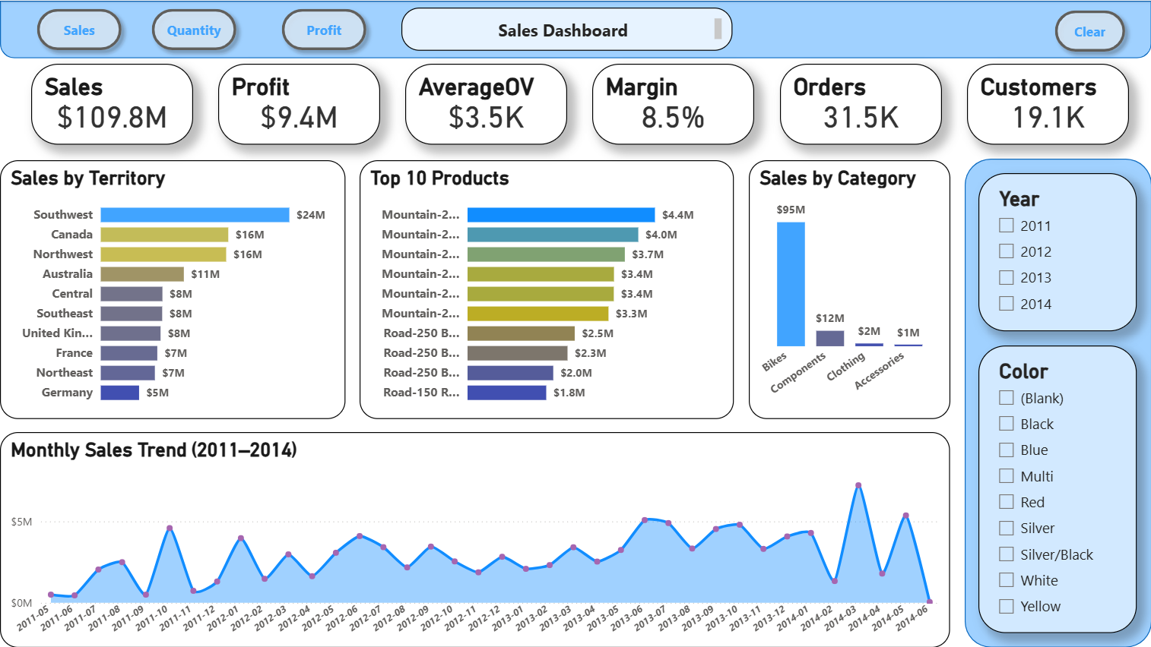
Author & Next Steps
Author: Nour. GitHub: https://github.com/nour-1928. LinkedIn: https://www.linkedin.com/in/noureldeenmohammad
Deliverables
Interactive single-page Power BI dashboard (.pbix), SQL scripts, documentation, and visual assets.
Recommended Next Steps
Schedule stakeholder walkthroughs, add automated refresh, extend KPIs, and version the PBIX in GitHub for collaboration.

Slide 11
Thank You

